Slide 1

Project Presentation
on
STOCK Analysis
Presented By:
ANIKET PATIDAR (Reg. No. 2025PUFCE22735)
ARUN VERMA (Reg. No.2025PUFCE21280)
PRASOON KUMAR(Reg. No. 2025PUFCE24434)
HIMANSHU (Reg. No. 2025PUFCE21232)
Department of First Year
Poornima University, Jaipur
Under the Supervision of
Dr. Sumit Kumar Kapoor
Assistant Professor,
Faculty of Computer Science and Engineering,
Poornima University, Jaipur
Submitted To:
Department of First Year
Poornima University, Jaipur

Slide 2
INTRODUCTION
In today’s fast-paced financial world, investors and analysts depends heavily on real-time data to make informed decisions.
This project aims to build a web based stock analysis dashboard using HTML,CSS and JavaScript integrated with Alpha Vantage API.
The goal is to provide users with an interactive platform to visualize and analyze stock market trends, empowering them with insights into price movements, historical data, and technical indicators.
The goal is to create a user-friendly web application that fetches live stock market data such as current price, trading volume and displays it dynamically on a responsive webpage.
This project serves as an excellent hands-on learning experience for beginners and intermediate developers, combining core front-end technologies with real-world API integration.

Slide 3
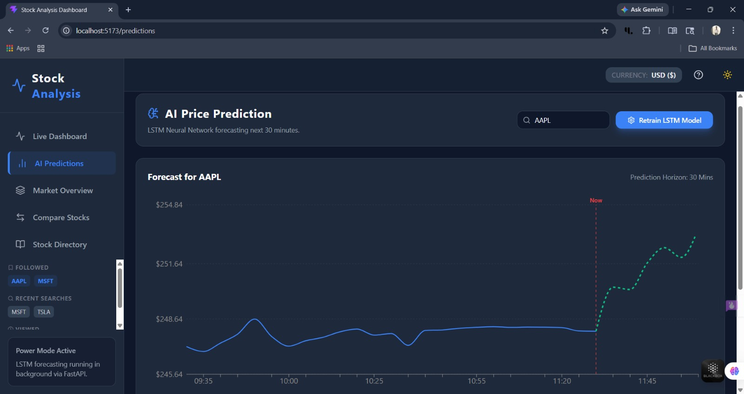

Slide 4
Scope and Objective
Stock Analysis is a popular project that combines data analysis, machine learning, and financial market understanding to forecast future stock values based on historical data.
This project typically includes fetch live and historical stock data using the Alpha Vantage API. To display stock trends using different interactive charts, tables and graphs. Designing a responsive front-end using HTML and CSS.
Implementing JavaScript features for dynamic updates, filtering and comparisons. Ensuring the dashboard work across devices and browsers.
The objective of a project is to create a web application that fetches and display stock data in a user-friendly format.
It allows user to monitor live stock prices and historical trends. Uses charts and graphs to make complex financial data easier to understand.
To design a clean, responsive interface that ensures smooth navigation and usability.
It helps to develop web development skills in solving real-world financial analysis problems.

Slide 5
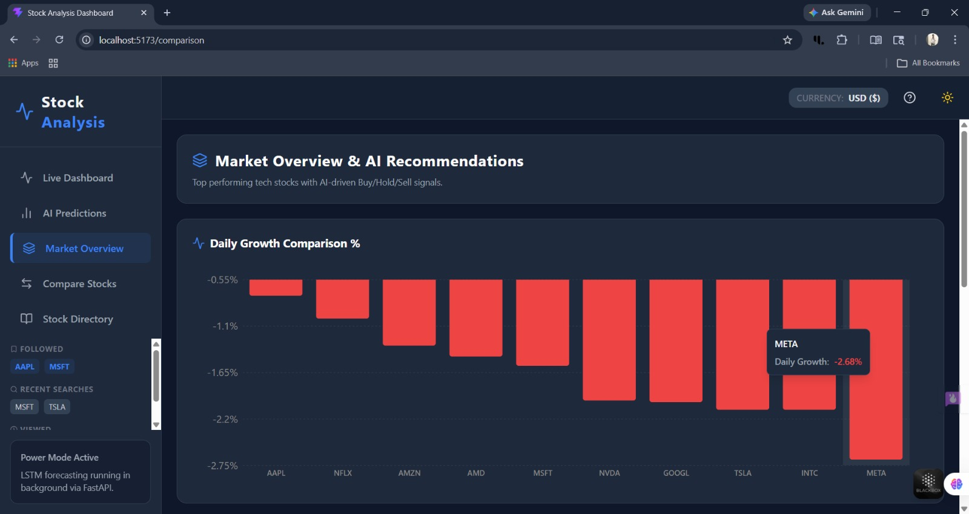

Slide 6
AIM OF PROJECT
The main aim of the project is to design and develop a web-based stock analysis dashboard that allows user to :
Fetch real-time and historical stock data using the Vintage API.
Visualize stock trends using interactive charts and graphs built in JavaScript.
Provide insights into stock performance through key metrics (Current Price, Open Price, Day Low,
Day High).
Provide Stock Comparison to compare two stocks.
Provide direct access of Stocks from Stock Directory (i.e. collection of many stocks).
Provide Price Alert option to set price alert above or below.
Enhance user experience with a clean, responsive interface using HTML and CSS.
Enable decision making support for investors, students and researchers by presenting financial data in a structured and accessible way.

Slide 7
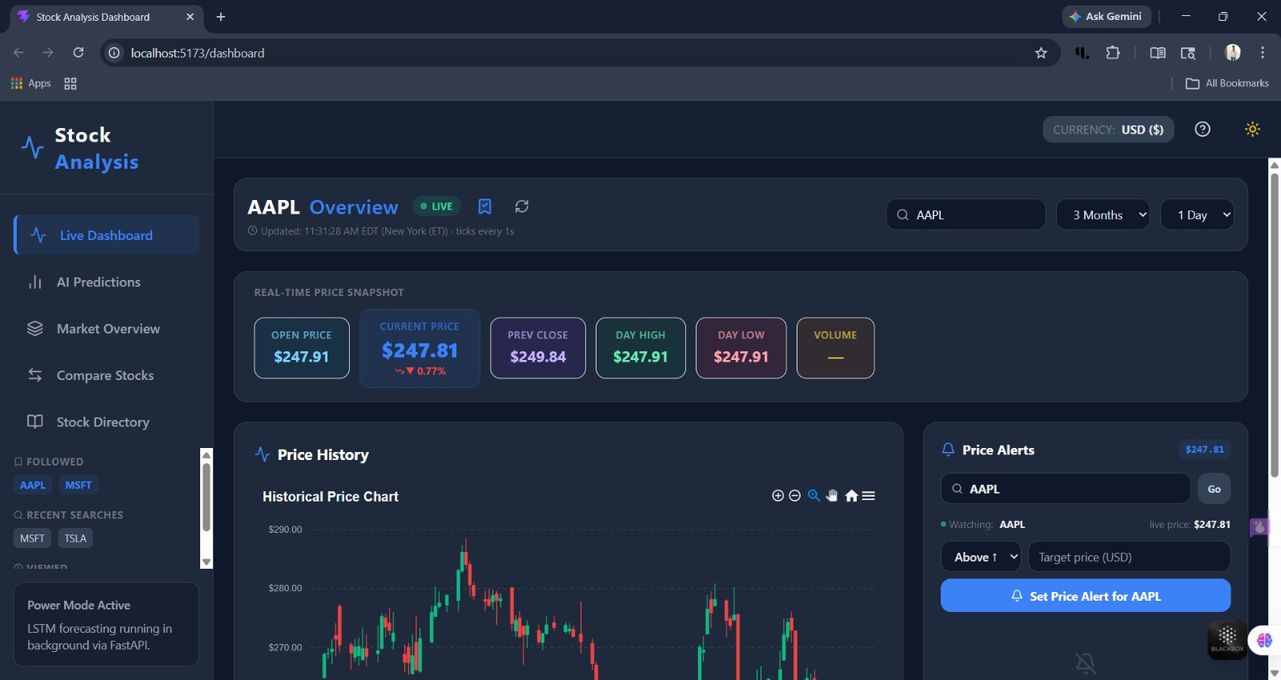

Slide 8
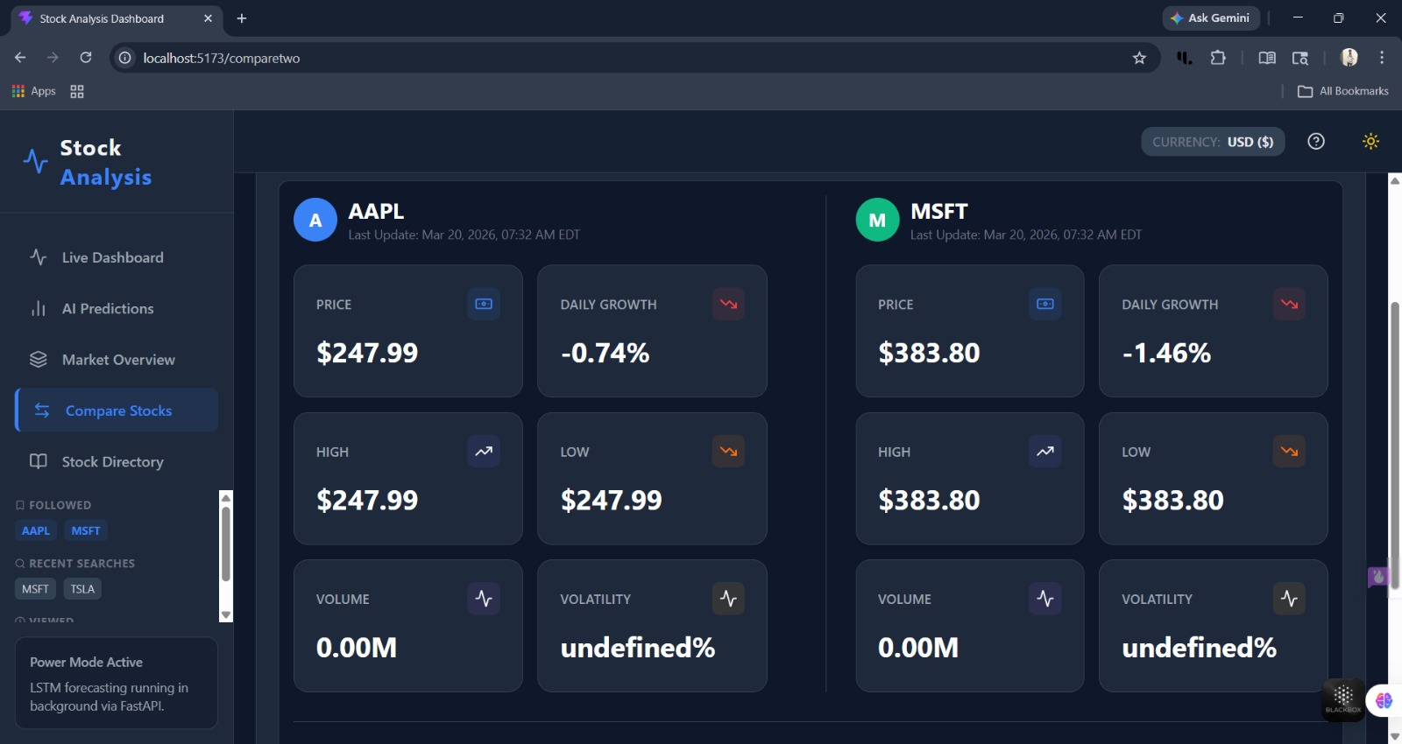

Slide 9
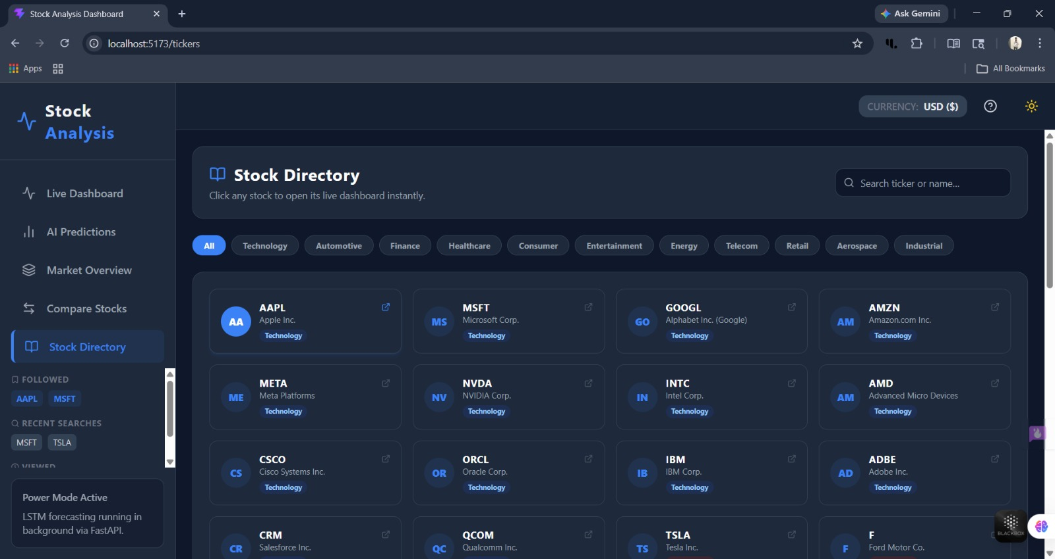

Slide 10
WORKING OF PROJECT
Frontend Setup (HTML + CSS) :
HTML structures the webpage: search bar, input fields for stock symbols, and chart containers.
CSS styles the interface: responsive layout, color themes, and user-friendly design for better readability.
API Integration (Vintage API) :
The Vintage API provides stock market data (historical prices,volumes, etc.)
Using JavaScript’s fetch() method, the webpage sends request to API with parameters like Stock symbol, Data range.
The API responds with JSON data containing stock information.
Data Processing (JavaScript) :
JavaScript extracts relevant fields (Open, Close, High, Low, Volume)
Libraries like Chart.js and D3.js are used to plot :
Line charts for stock price trends.
Bar charts for trading volume.
Comparative graphs for multiple stocks.
Interactive features allow user to hover, zoom, filter data, download charts.

Slide 11
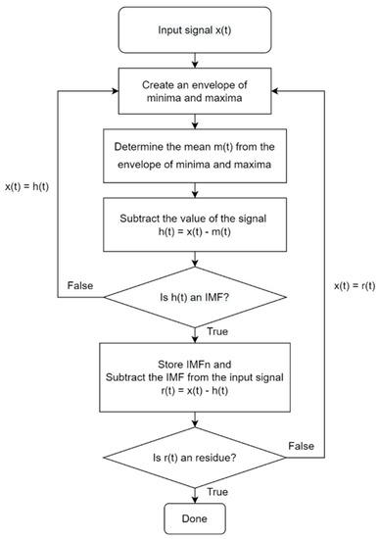
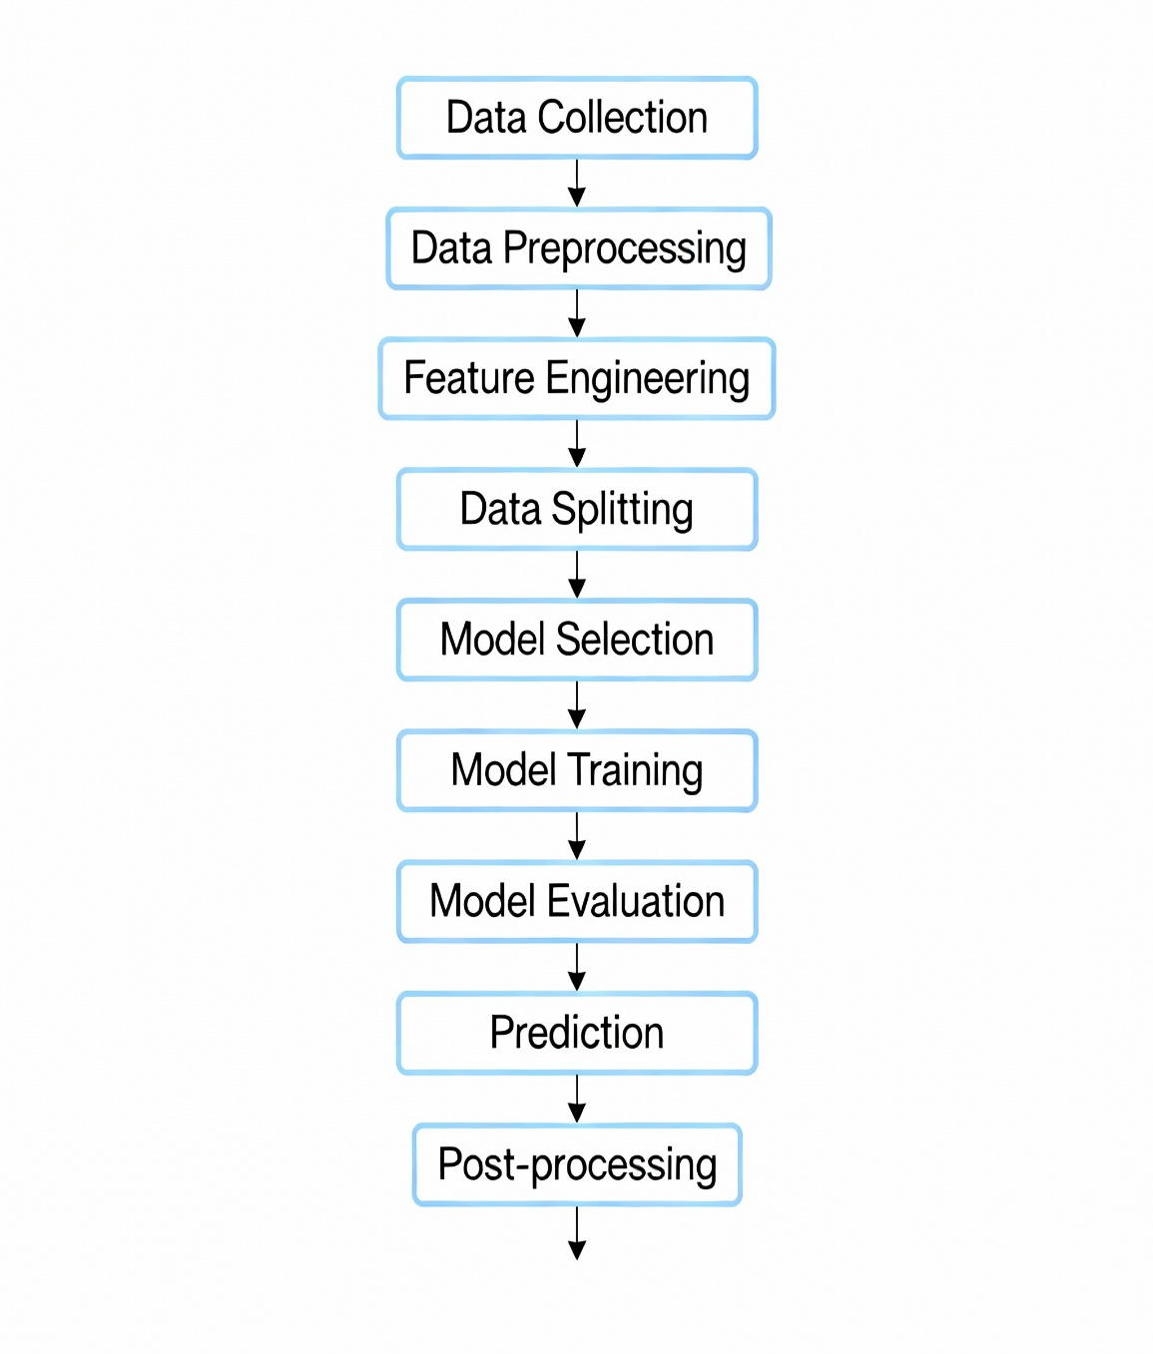
Flowchart of Working of Project

Slide 12
FUTURE USE
Future applications of stock analysis projects using HTML, CSS, JavaScript, and Alpha Vantage (Vintage API) focus on building real-time data dashboards, predictive trend tools, and custom trading analytics.
Future uses of Stock analysis system are:
Users can monitor live stock prices instantly.
Helps user analyze trends and patterns. It also guide users when to buy or sell.
Notify users when stock reaches a target price and when sudden market change happens.
Users can track their investments and monitor their profit and loss.
It can be used by students to learn stock market basics and practice with virtual trading.

Slide 13
CONCLUSION
The Stock Analysis project successfully demonstrates how web technologies (HTML, CSS, JavaScript) can be integrated with the Vintage API to create an interactive and user-friendly dashboard for financial data visualization. By combining a structured interface, dynamic data fetching, and graphical representation, the project bridges the gap between raw stock market data and meaningful insights.
Key achievements include:
Seamless API integration for retrieving real-time and historical stock data.
Responsive frontend design that enhances accessibility and usability.
Interactive visualizations using JavaScript libraries, enabling users to analyze trends, compare stocks, and interpret performance metrics.
Practical application for investors, students, and researchers to understand market behavior and support decision-making.

Slide 14


